Slide 1
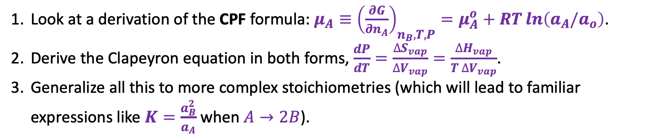
Today
Look at a derivation of the CPF formula: $μ_{A}≡{\left(\frac{∂G}{∂n_{A}}\right)}_{n_{B}, T,P}=μ_{A}^{o}+RT\ln\left(a_{A}/a_{o}\right)$.
Derive the Clapeyron equation in both forms, $\frac{dP}{dT}=\frac{∆S_{vap}}{∆V_{vap}}=\frac{∆H_{vap}}{T ∆V_{vap}}$.
Generalize all this to more complex stoichiometries (which will lead to familiar expressions like $K=\frac{a_{B}^{2}}{a_{A}}$ when $A→2B$).

Slide 2
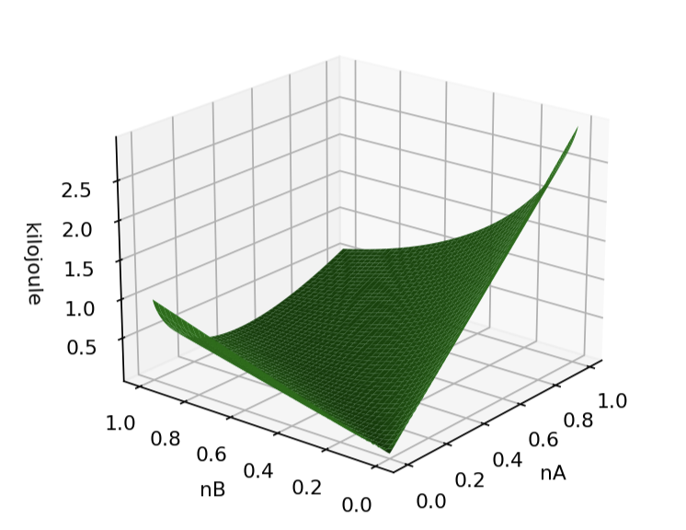
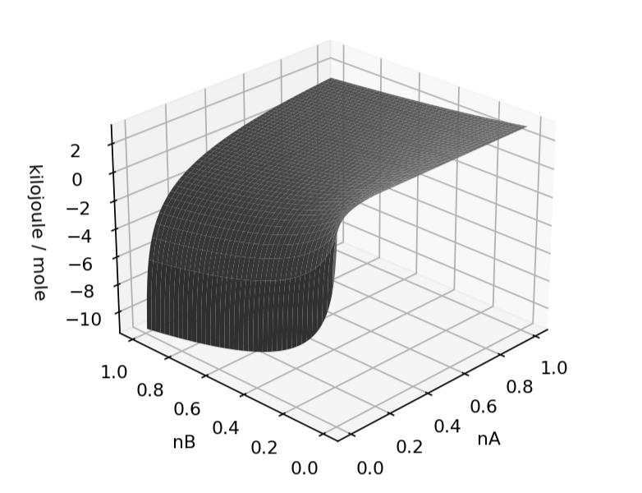

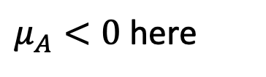
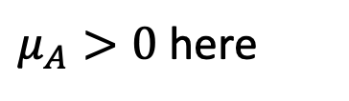

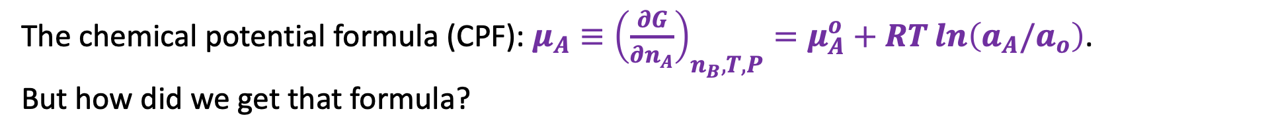
CPF: we presented an algebraic expression for the slopes of $G(n_{A},n_{B})$
$$G(n_{A},n_{B})$$
$$μ_{A}(n_{A},n_{B})$$
$μ_{A}>0$ here
$μ_{A}<0$ here
The chemical potential formula (CPF): $μ_{A}≡{\left(\frac{∂G}{∂n_{A}}\right)}_{n_{B}, T,P}=μ_{A}^{o}+RT\ln\left(a_{A}/a_{o}\right)$.
But how did we get that formula?

Slide 3
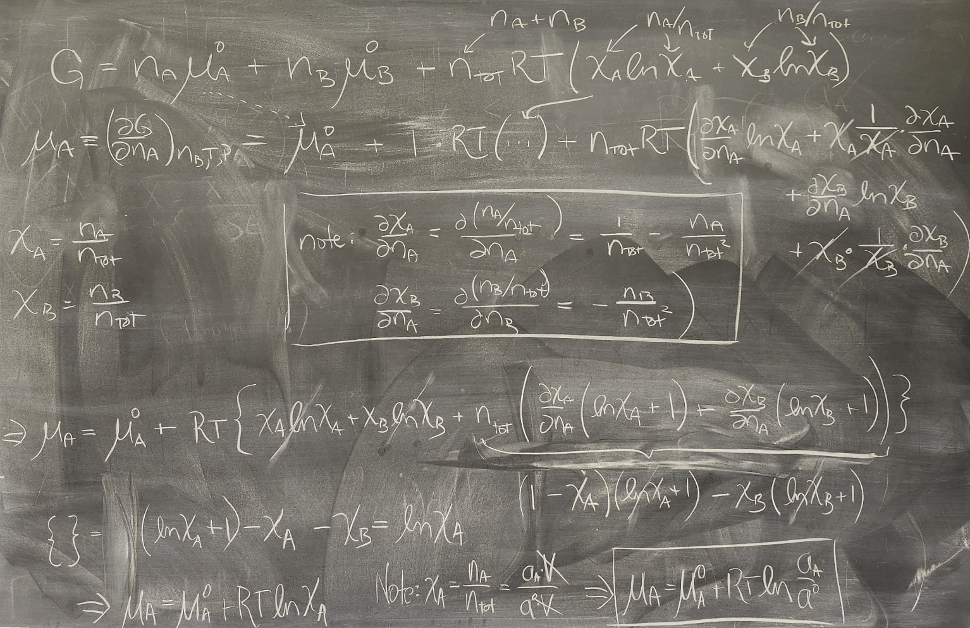
1. A look at a derivation of the CPF formula focusing on solutes (Nesh’s solution)

Slide 4
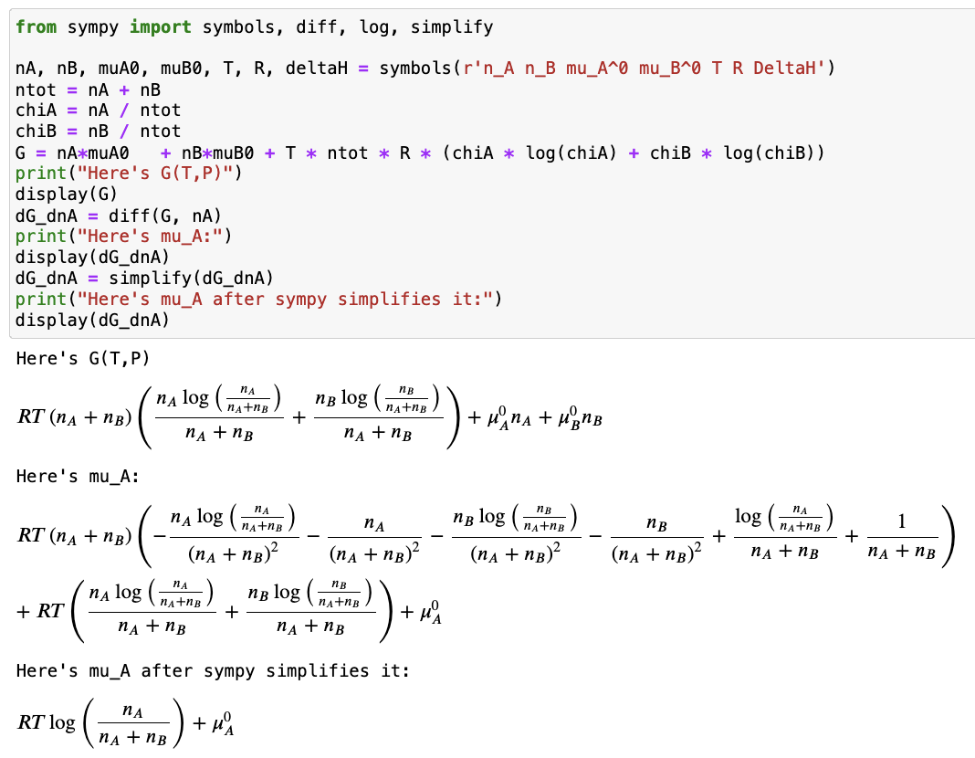
1. A look at a derivation of the CPF formula focusing on solutes (Daniel’s solution)

Slide 5
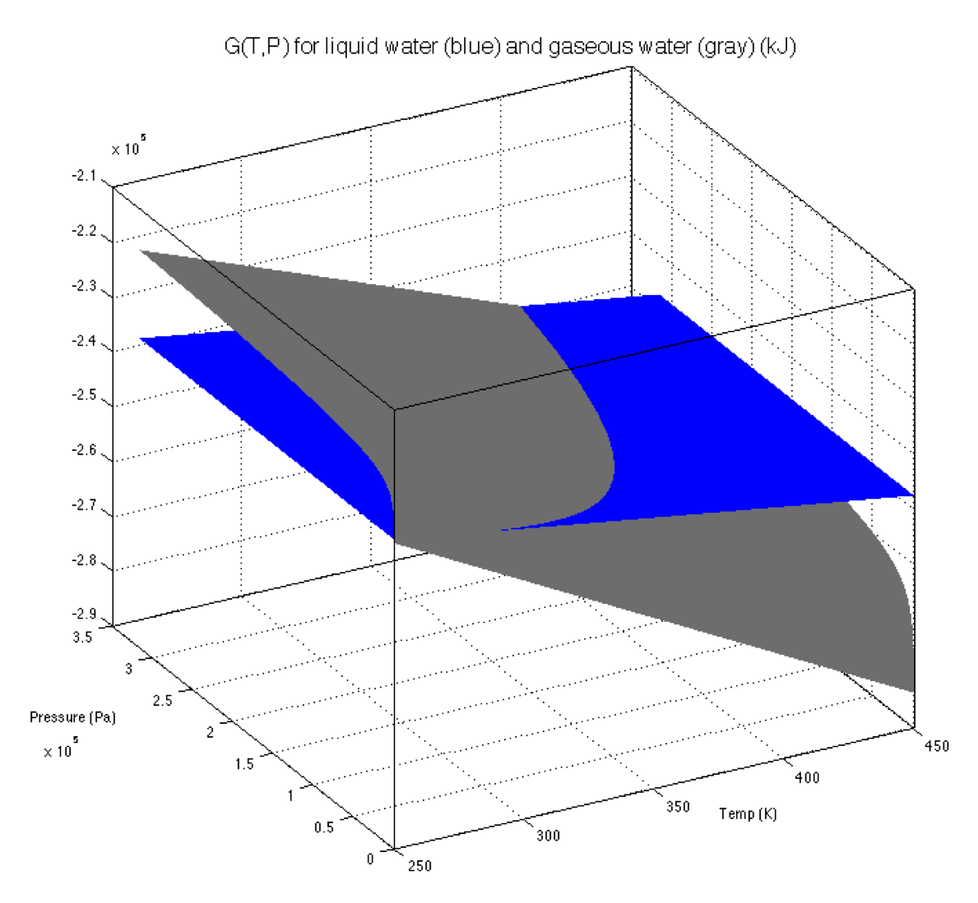
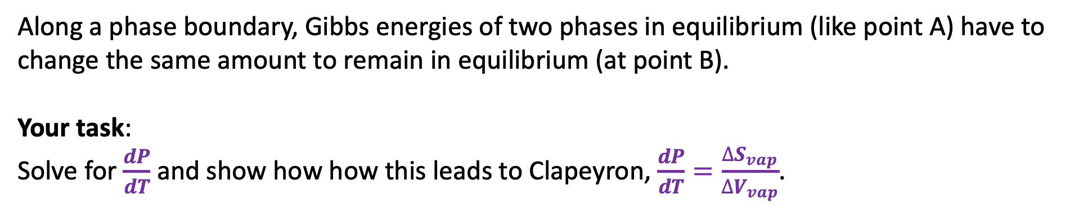
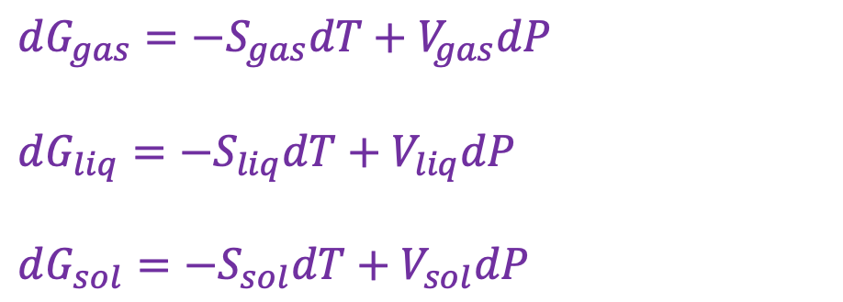
2. Deriving the Clapeyron equation
$dG_{gas}=−S_{gas}dT+V_{gas}dP$
$dG_{liq}=−S_{liq}dT+V_{liq}dP$
$dG_{sol}=−S_{sol}dT+V_{sol}dP$
B
A
Along a phase boundary, Gibbs energies of two phases in equilibrium (like point A) have to change the same amount to remain in equilibrium (at point B).
Your task:
Solve for $\frac{dP}{dT}$ and show how how this leads to Clapeyron, $\frac{dP}{dT}=\frac{∆S_{vap}}{∆V_{vap}}$.

Slide 6
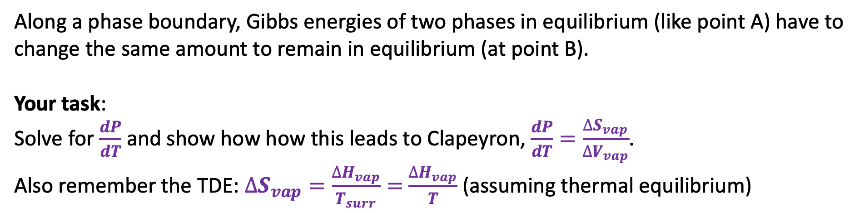
2. Deriving the Clapeyron equation
$dG_{gas}=−S_{gas}dT+V_{gas}dP$
$dG_{liq}=−S_{liq}dT+V_{liq}dP$
$dG_{sol}=−S_{sol}dT+V_{sol}dP$
B
A
Along a phase boundary, Gibbs energies of two phases in equilibrium (like point A) have to change the same amount to remain in equilibrium (at point B).
Your task:
Solve for $\frac{dP}{dT}$ and show how how this leads to Clapeyron, $\frac{dP}{dT}=\frac{∆S_{vap}}{∆V_{vap}}$.
Also remember the TDE: $∆S_{vap}=\frac{∆H_{vap}}{T_{surr}}=$ $\frac{∆H_{vap}}{T}$ (assuming thermal equilibrium)

Slide 7
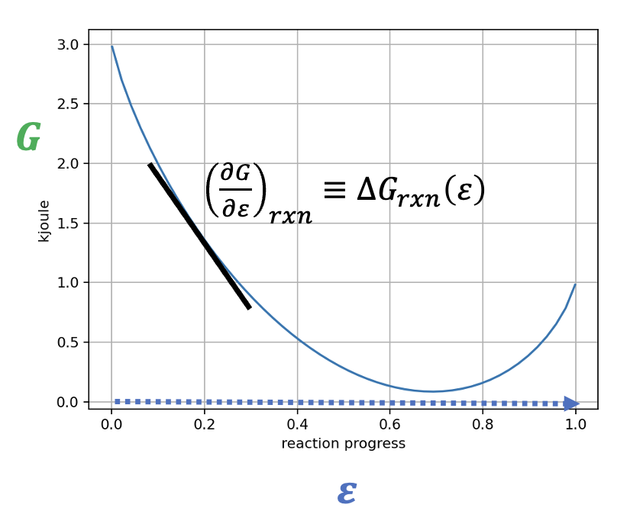
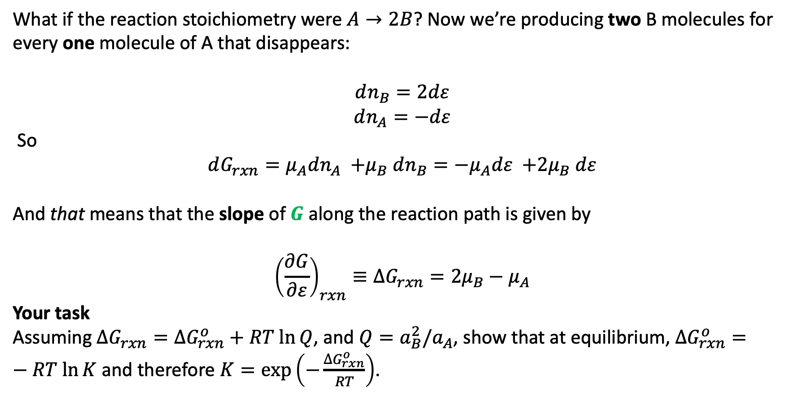
3. Generalizing the connection between $μ_{A}$, $μ_{B}$,${\left(\frac{∂G}{∂ε}\right)}_{rxn}≡∆G_{rxn}\left(ε\right)$, $Q$, and $K$
What if the reaction stoichiometry were $A→2B$? Now we’re producing two B molecules for every one molecule of A that disappears:
$$dn_{B}=2dε$$
$$dn_{A}=−dε$$
So
$$dG_{rxn}={μ_{A}dn_{A} {+μ}_{B}dn_{B}=−μ}_{A}dε {+2μ}_{B}dε$$
And that means that the slope of $G$ along the reaction path is given by
$${\left(\frac{∂G}{∂ε}\right)}_{rxn}≡∆G_{rxn}={2μ}_{B}−μ_{A}$$
Your task
Assuming $∆G_{rxn}=∆G_{rxn}^{o}+RT ln⁡Q$, and $Q=a_{B}^{2}/a_{A}$, show that at equilibrium, $∆G_{rxn}^{o}=−RT ln⁡K$ and therefore $K=\exp\left(−\frac{∆G_{rxn}^{o}}{RT}\right)$.

Slide 8
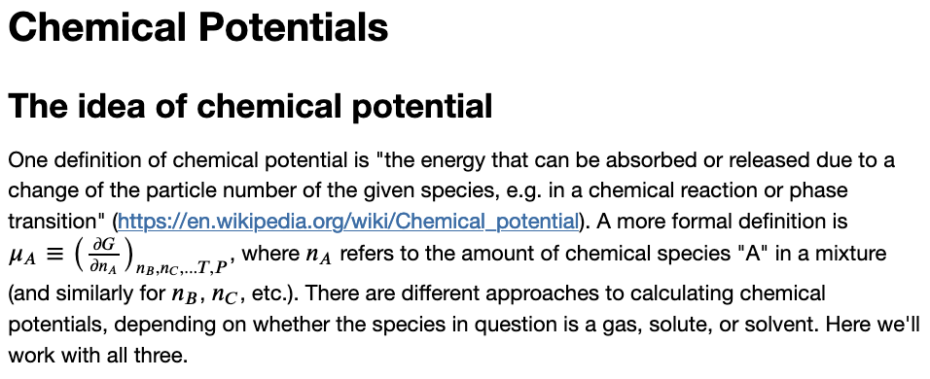
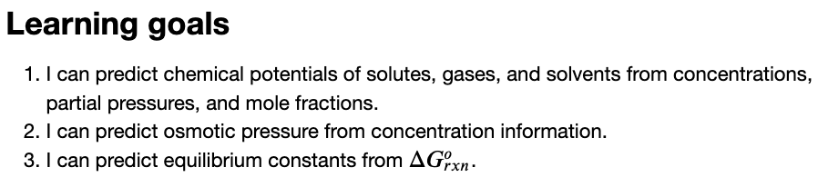
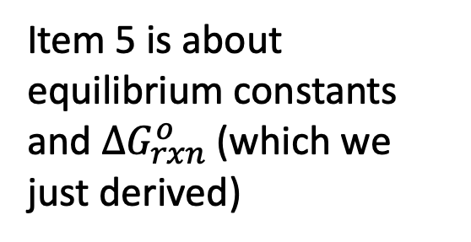
The last part of the CGI associated with this
Item 5 is about equilibrium constants and $∆G_{rxn}^{o}$ (which we just derived)

